Slide 1



Programming Quantum Computers

Slide 2
Qiskit
An open-source software development kit designed to be used for quantum computer programming through python
Founded by IBM Research to allow software development for their cloud quantum computing service, IBM Quantum Experience [source]
Allows the use of local simulators or interfacing with cloud based quantum services
Qiskit programs are written at the quantum circuit level
Docs

Slide 3
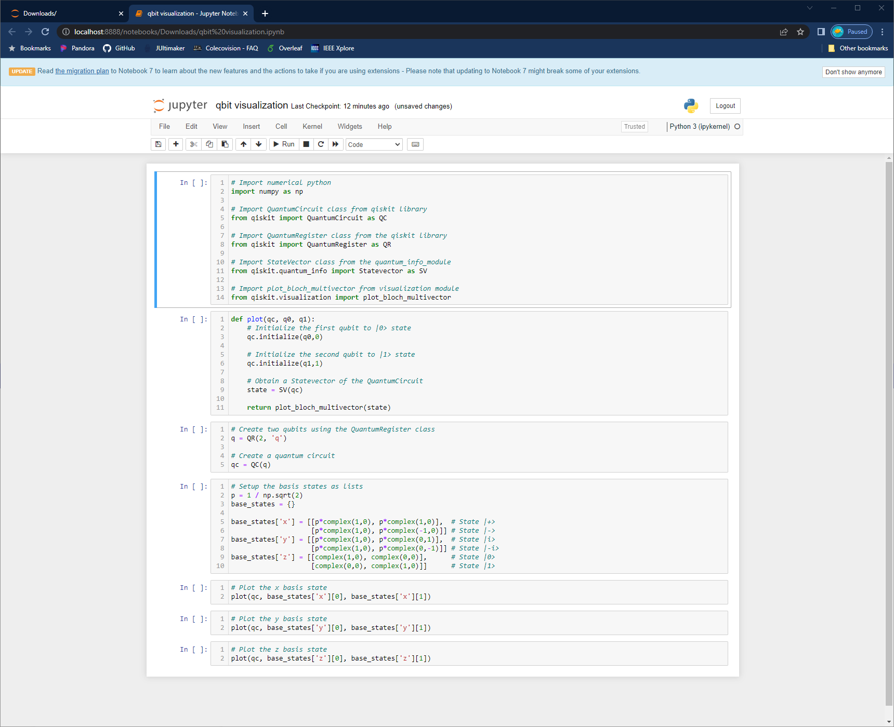
Qbit visualization
Open the jupyter notebook qbit visualization.ipynb

Slide 4
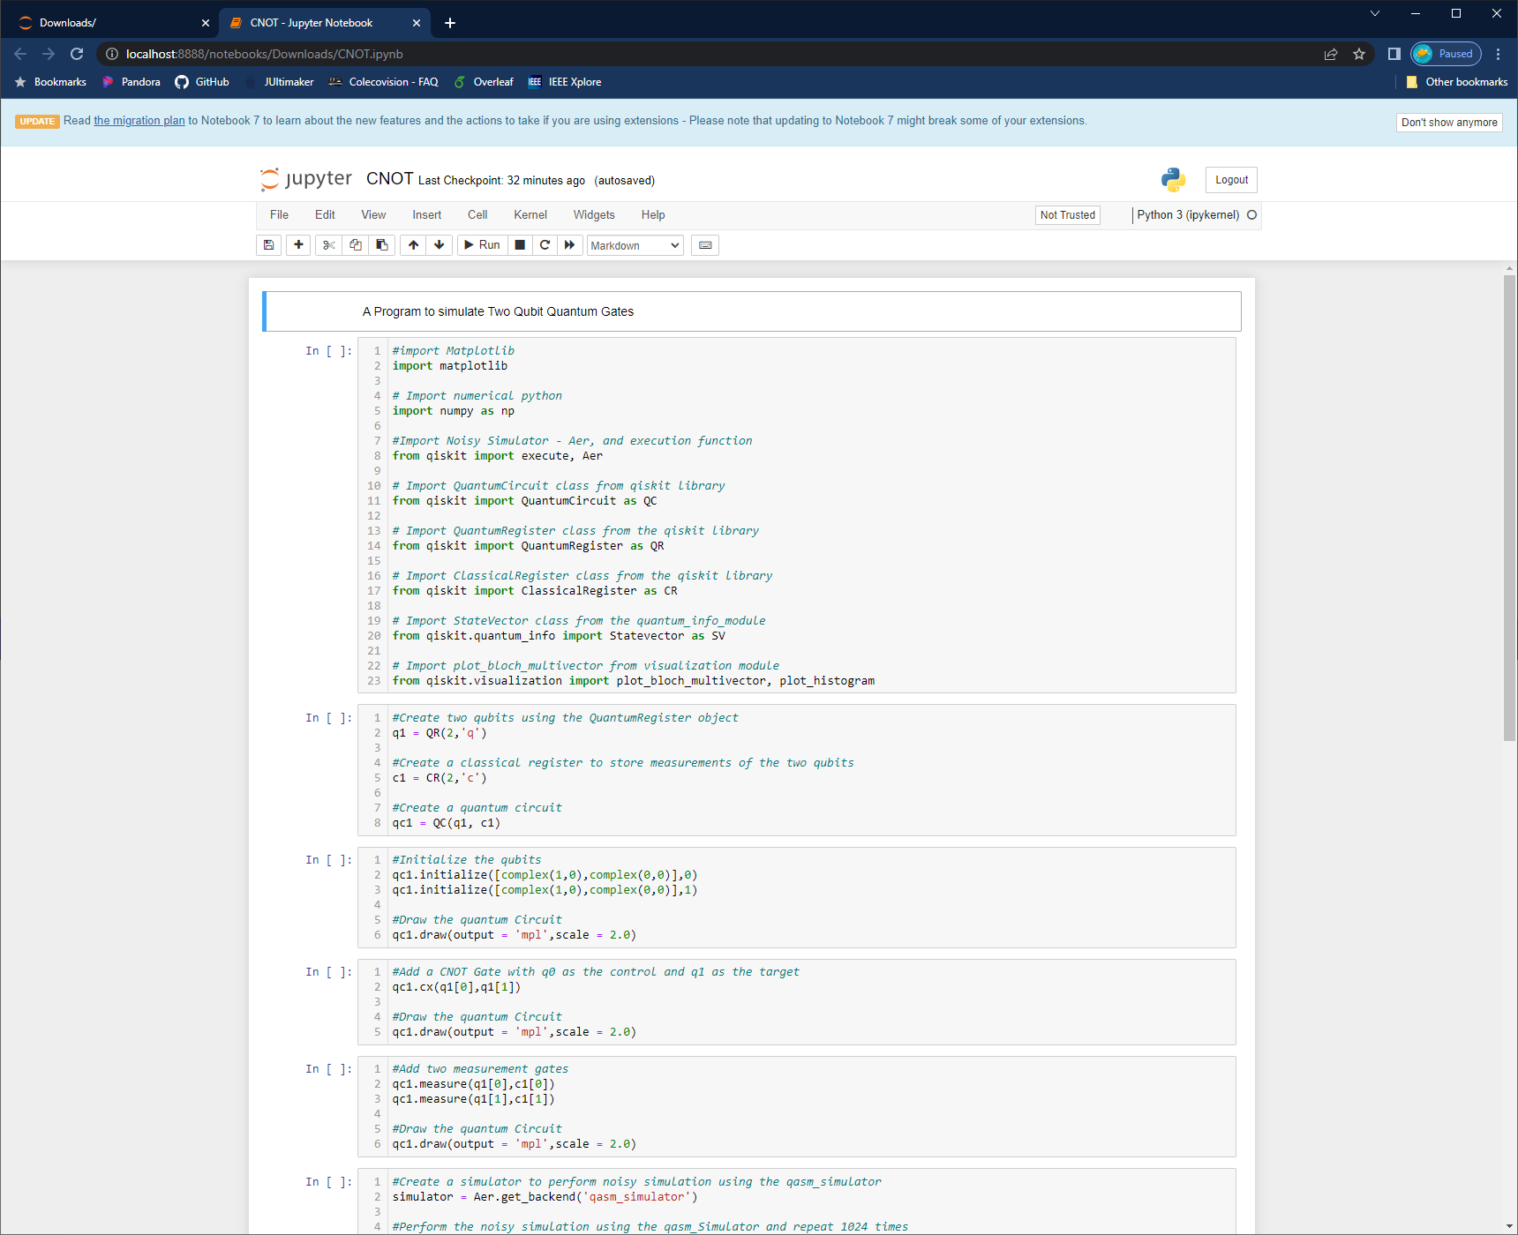
controlled Not Gate
Open the jupyter notebook cnot.ipynb

